Slide 1

What Has Niall Been Doing?
Update for Group Meeting 05/14/24

Slide 2
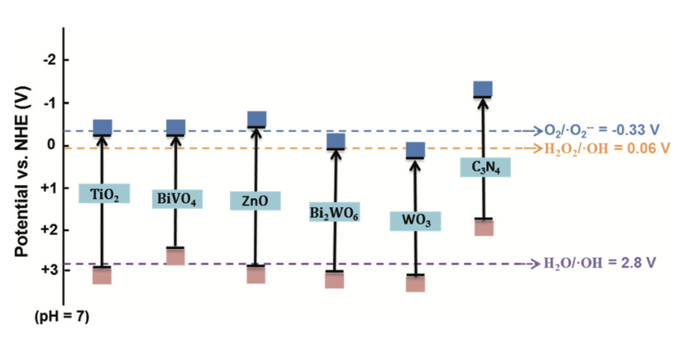
Motivation – Understanding Photocatalysis
Photocatalysis – How dopants affect the performance of photocatalysts
Alignment of the Valence Band
If aligned with vacuum level can align with NHE
Know the Band Gap from UV-Vis
Figure 1. The Valence Band and Conduction Band Positions of Common Photocatalysts. Adapted from Green Chem. 2021, 23, 3526.
Notes:
Put in band alignments from that review paper

Slide 3
PHY 365 – XPS Project
Understanding the XPS system
Calibration of the XPS using Au / Cleaning
Measurement of the Valence Band of P90
Determination of the position in which the first electrons can be photoexcited
Intercept Method vs 2nd Derivative Method

Slide 4
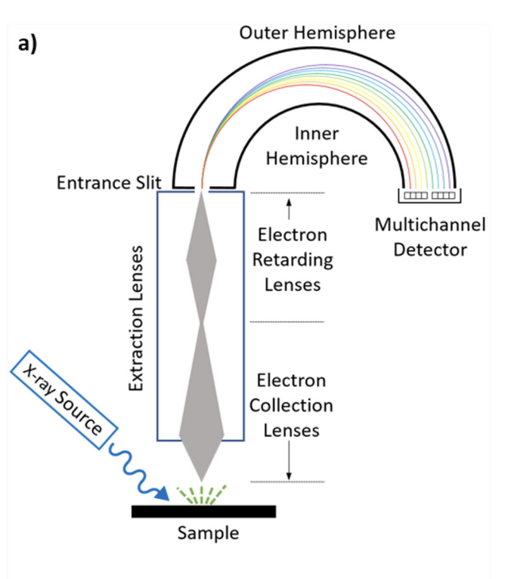
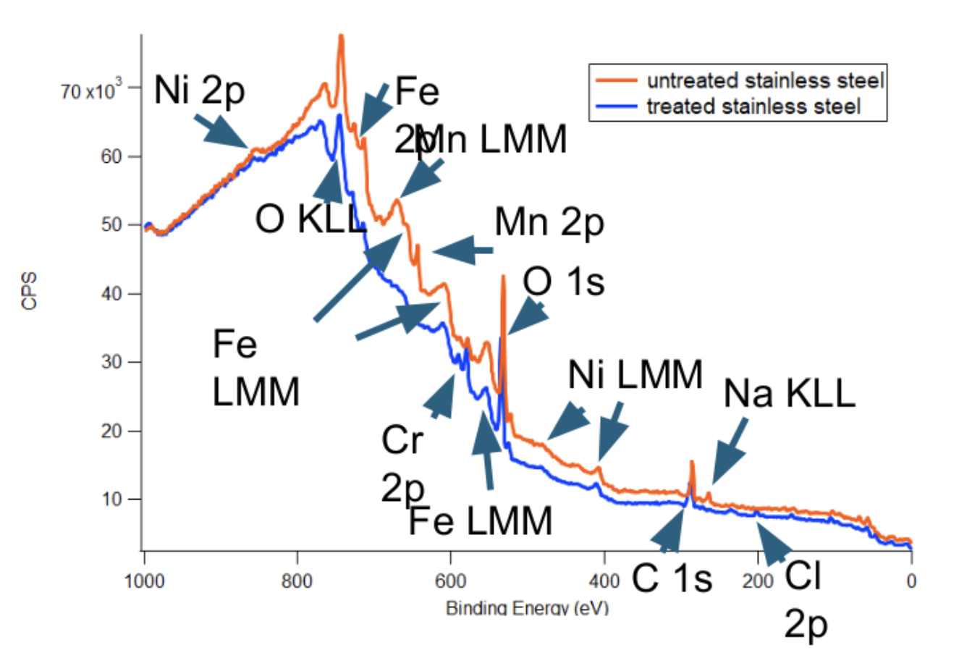
Basics of XPS
Figure 2. XPS Instrument. Adapted from J. Vac. Sci. Technol. A 38(6) Nov/Dec 2020; doi: 10.1116/6.0000412

Slide 5
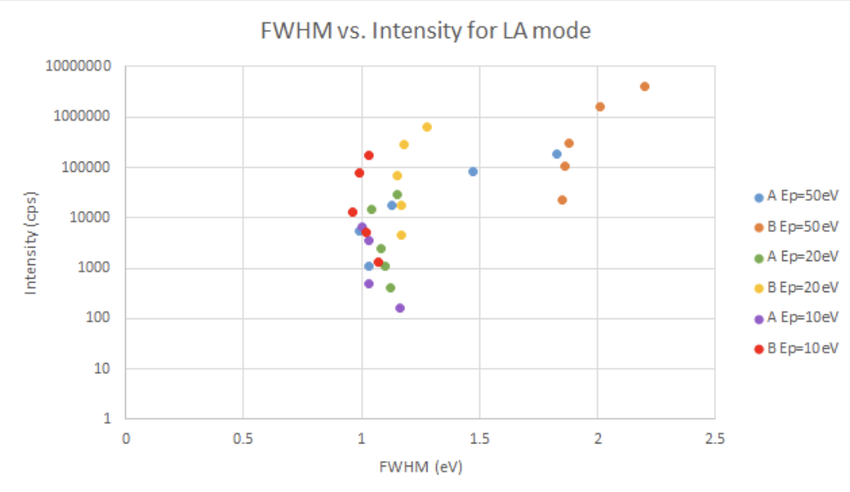

Basic operation – Optics
Resolution
$ΔE_{k}=\frac{ΔR}{D}∙E_{p}$
Decrease in Entrance Slit
Figure 4. Count Rate and Resolution for Different Optics of XPS

Slide 6
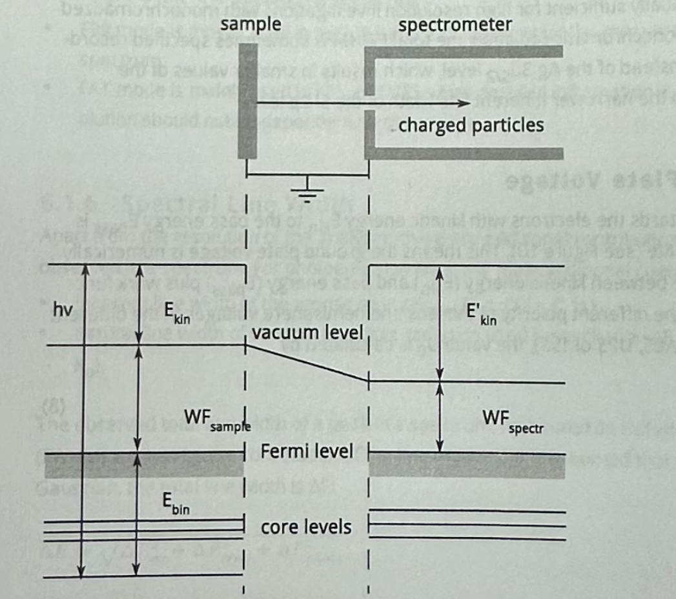



Understanding the XPS System
$$hν=E_{K}+E_{B}+WF_{sample}$$
$$hν={E′}_{K}+E_{B}+WF_{spectr}$$
$$hν={E′′}_{K}+E_{B}$$
E’’_{K} is what the spectrometer measures! Which contains the work function of the spectrometer and measured kinetic energy. Factory WF: 4.1550eV
We think current work function is 4.709eV (for Gold)
cite

Slide 7
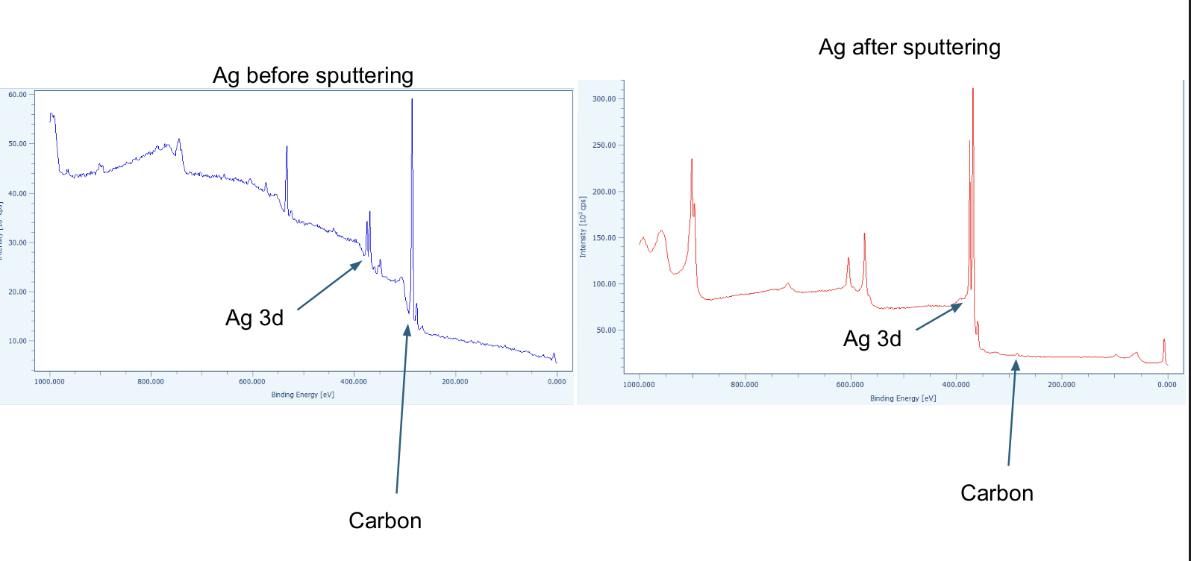
Cleaning!
Au: 24% of a monolayer of Carbon
Ag: 18% of a monolayer of Carbon

Slide 8
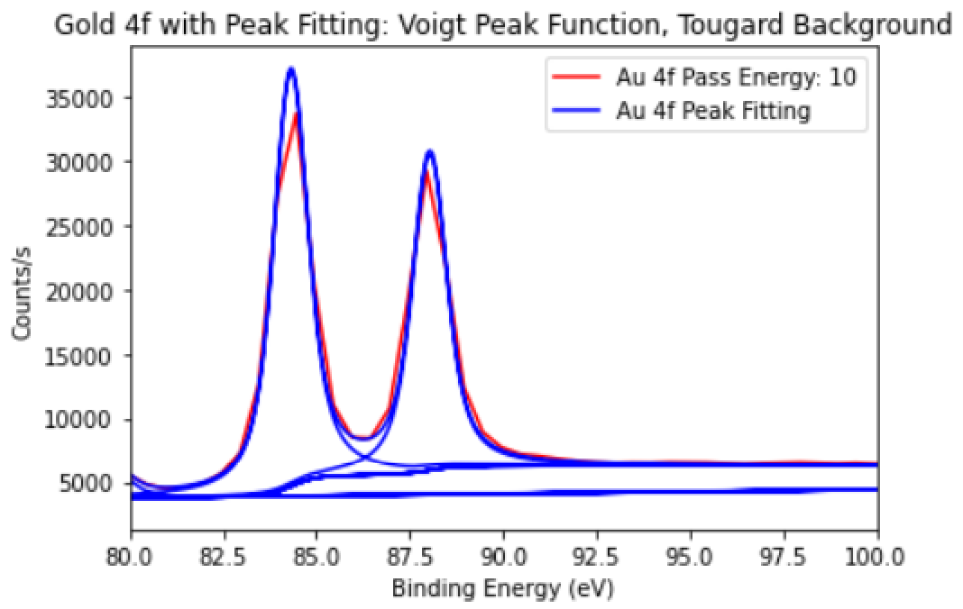
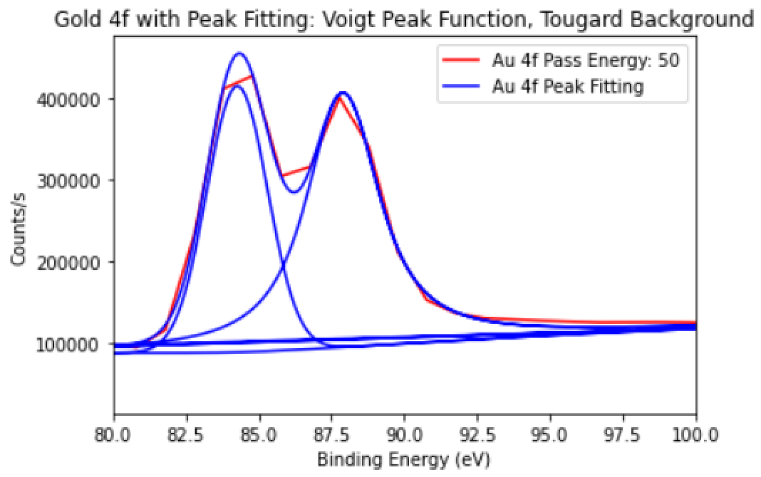
 | Ep = 10 eV | Ep = 50 eV | Literature
4f 7/2 Line Position | 84.35 eV | 84.30 eV | 83.8 eV*
Correction Factor | 0.554 eV | 0.501 eV
Work Function | 4.709 eV | 4.656 eV
*Johansson et al. doi: 10.1016/0368-2048(73)80022-2

Slide 9
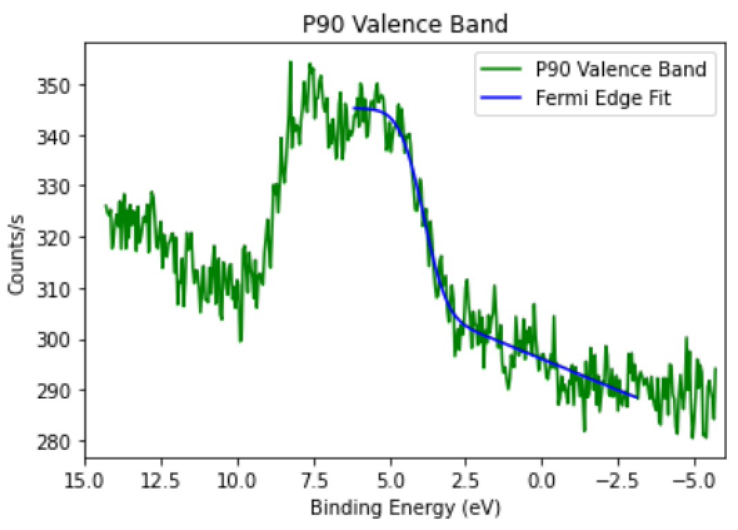
Measurement of P90 Valence Band

Slide 10
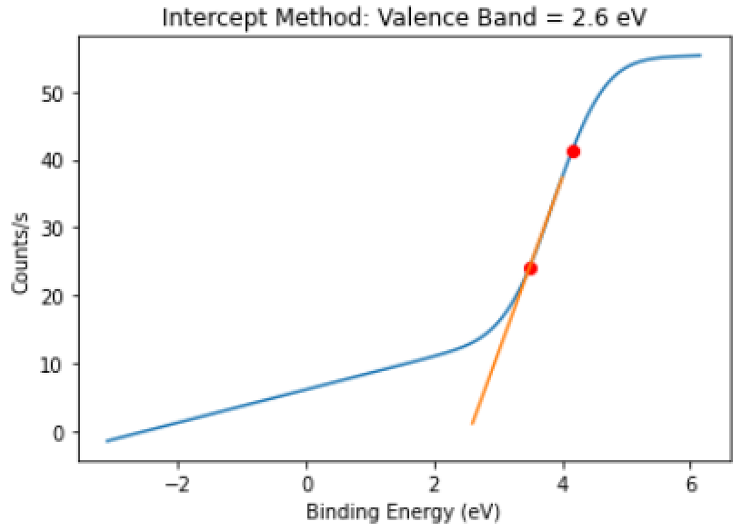
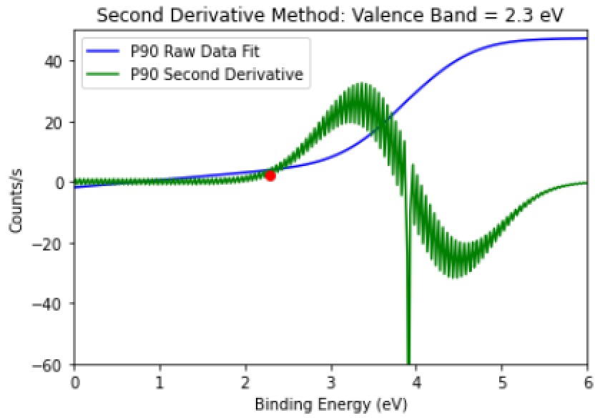
Intercept vs 2nd Derivative Method

Slide 11
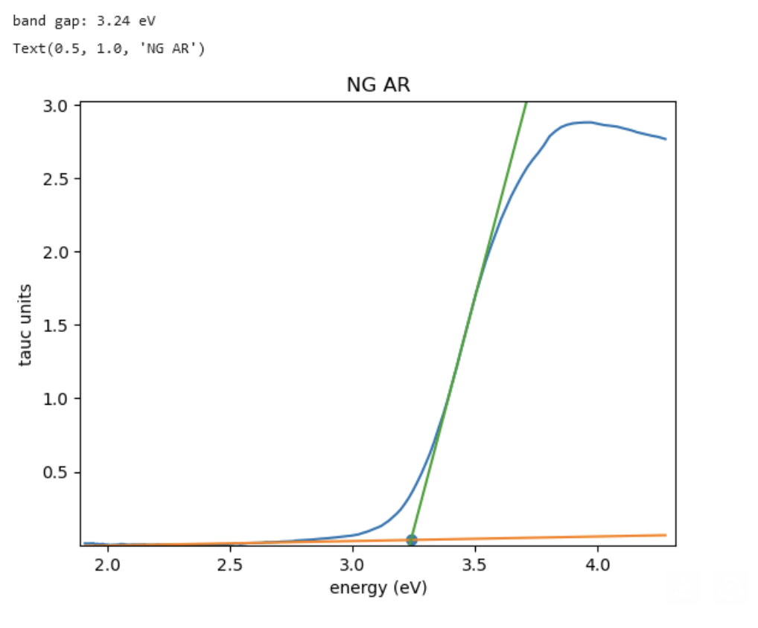
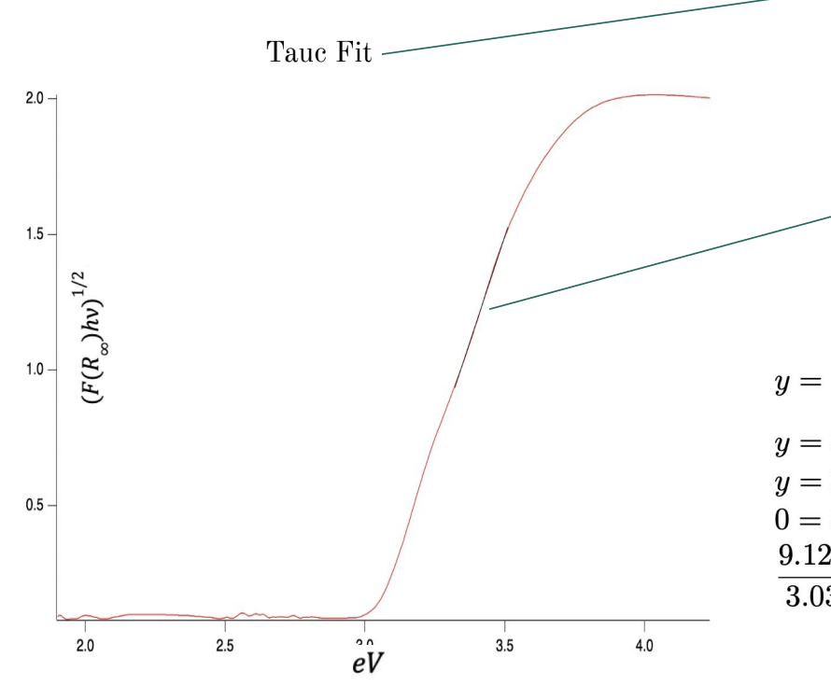
CB measurement from UV-vis
Figure 5. Tauc Plot from P25 Photocatalyst. Band Gap: 3.01 eV
Figure 6. Tauc Plot from Anatase Photocatalyst. Band Gap: 3.24 eV

Slide 12

Measurement of P90 Valence Band
P90
Figure 5. The Valence Band and Conduction Band Positions of Common Photocatalysts. Adapted from Green Chem. 2021, 23, 3526.
$$2.3 eV → +2.6V, vs NHE$$
Efermi = – 4.709eV - 2.3eV = -7.15eV
ENHE = -4.5 – (-7.15) = 2.65eV
From Huang et al. doi: 10.1021/acsomega.9b01969

Slide 13
Next Steps?
Measure Silver
Find a better fit?

